Slide 1

MAGNITUDE COMPARATOR AND PARALLEL ADDER CUM SUBTRACTOR
-By
Nayan Chaurasia
Harsh Misra
Manya Varshney
Karan Sharma
Nishant Singh
DESIGNATION – MRS. SWETA
ASSISTANT PROFESSOR
E.C. DEPARTMENT

Slide 2
Outline:
Objective
Introduction
Circuit Diagram
Components Used
Simulation Of The Project
Pictures Of Hardware Implementation
Applications
Reference

Slide 3
Objective:
The object of the project is to design and implement the four bit magnitude comparator and four bit parallel adder cum subtractor

Slide 4
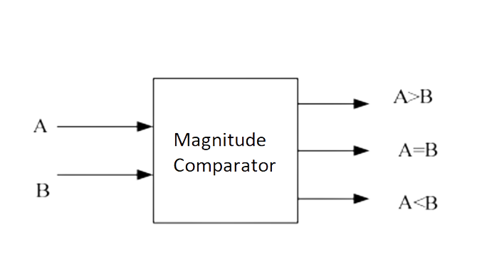
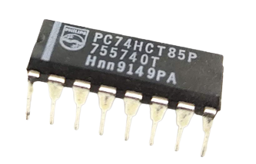
Introduction:
a) Four Bit Magnitude Comparator:
A magnitude digital Comparator is a combinational circuit that compares two digital or binary numbers in order to find out whether one binary number is equal, less than or greater than the other binary number
IC-7485

Slide 5
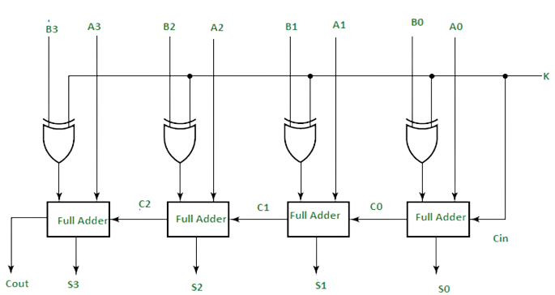
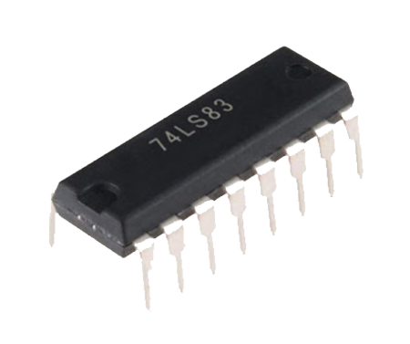
b) Four Bit Parallel Adder And Subtractor:
A Binary Adder-Subtractor is one which is capable of both addition and subtraction of binary numbers in one circuit itself. The operation being performed depends upon the binary value the control signal holds.
IC-7483

Slide 6
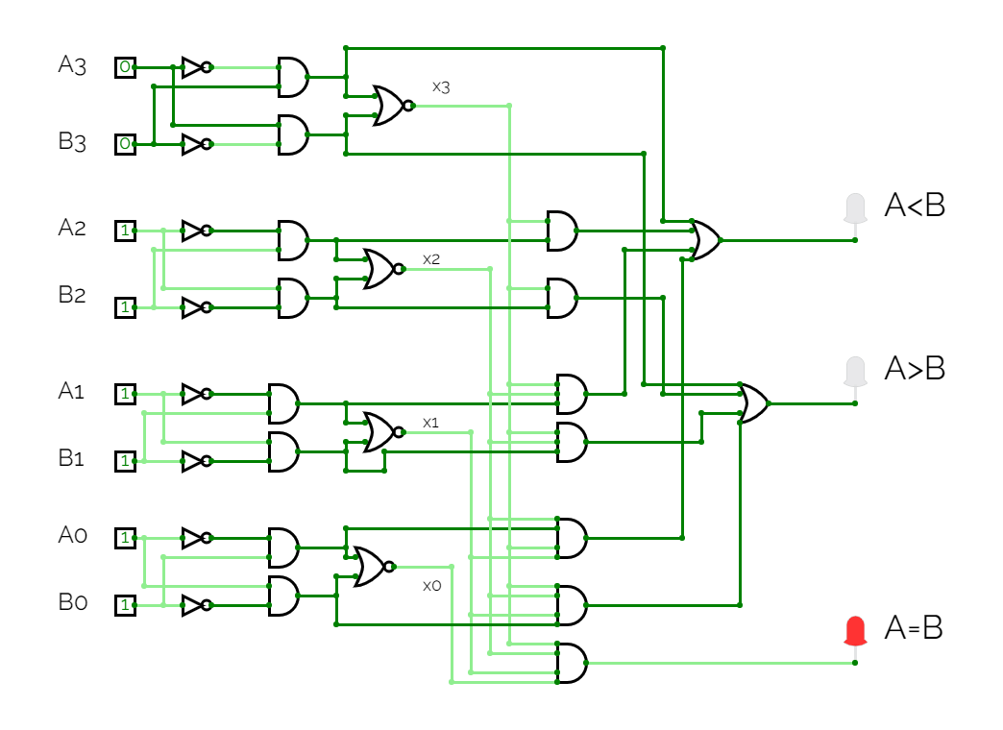
Circuit Diagram Of Magnitude Comparator:
A=A3A2A1A0
B=B3B2B1B0
A=0111
B=0111

Slide 7
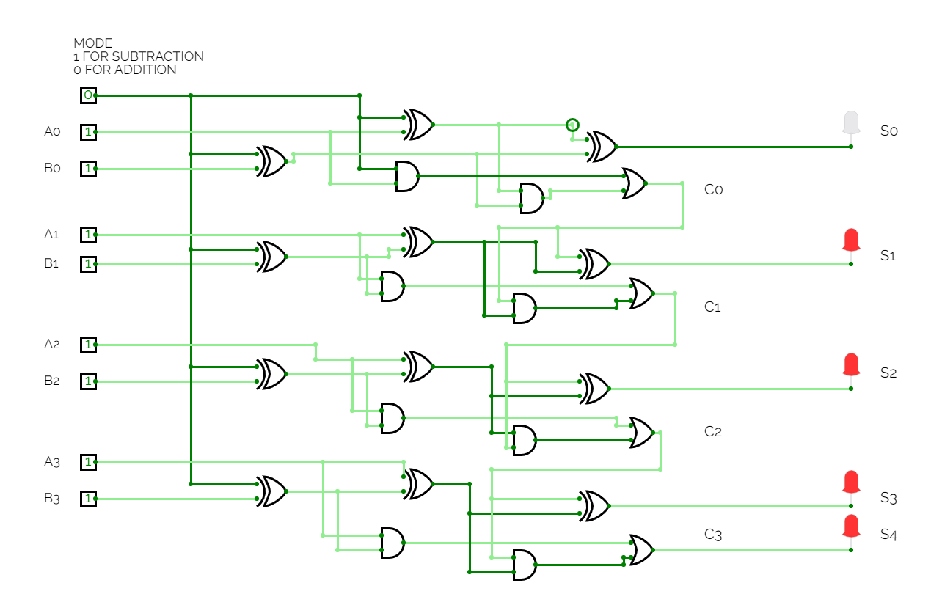
Circuit Diagram Of Four Bit Parallel Adder Cum Subtractor:
A=A3A2A1A0
B=B3B2B1B0
S=S4S3S2S1S0
A=1111(15)
B=1111(15)
S=11110(30)

Slide 8
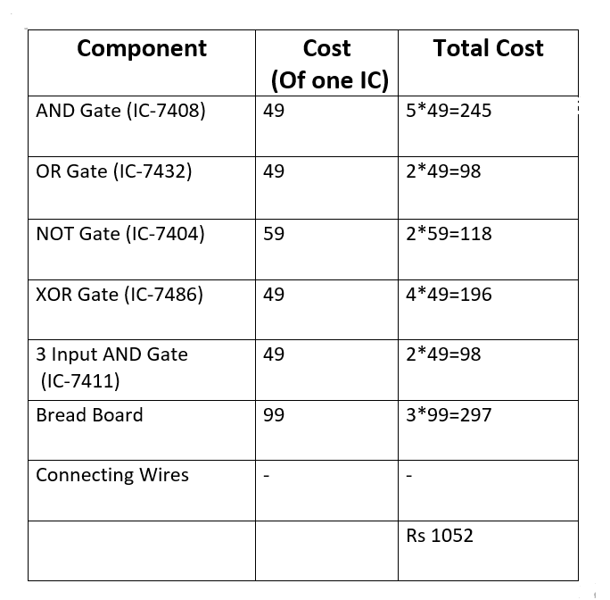
Components Used:

Slide 9
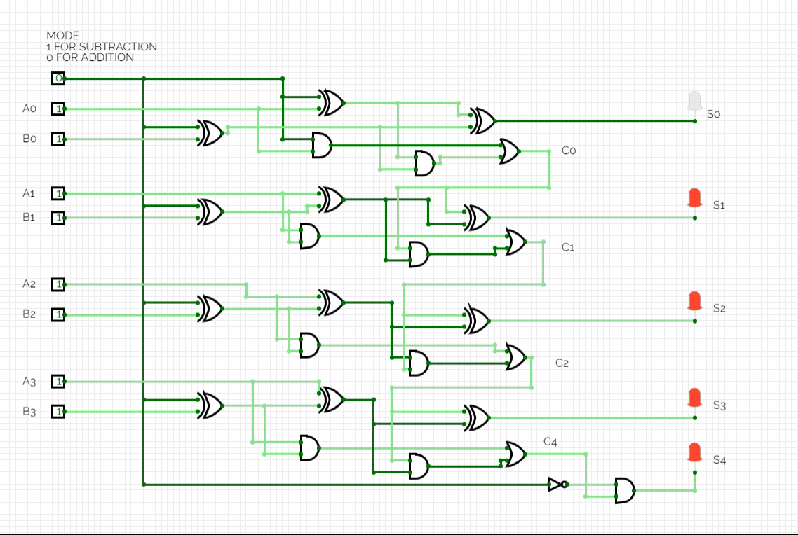
Simulation Of Parallel Adder Cum Subtractor:

Slide 10
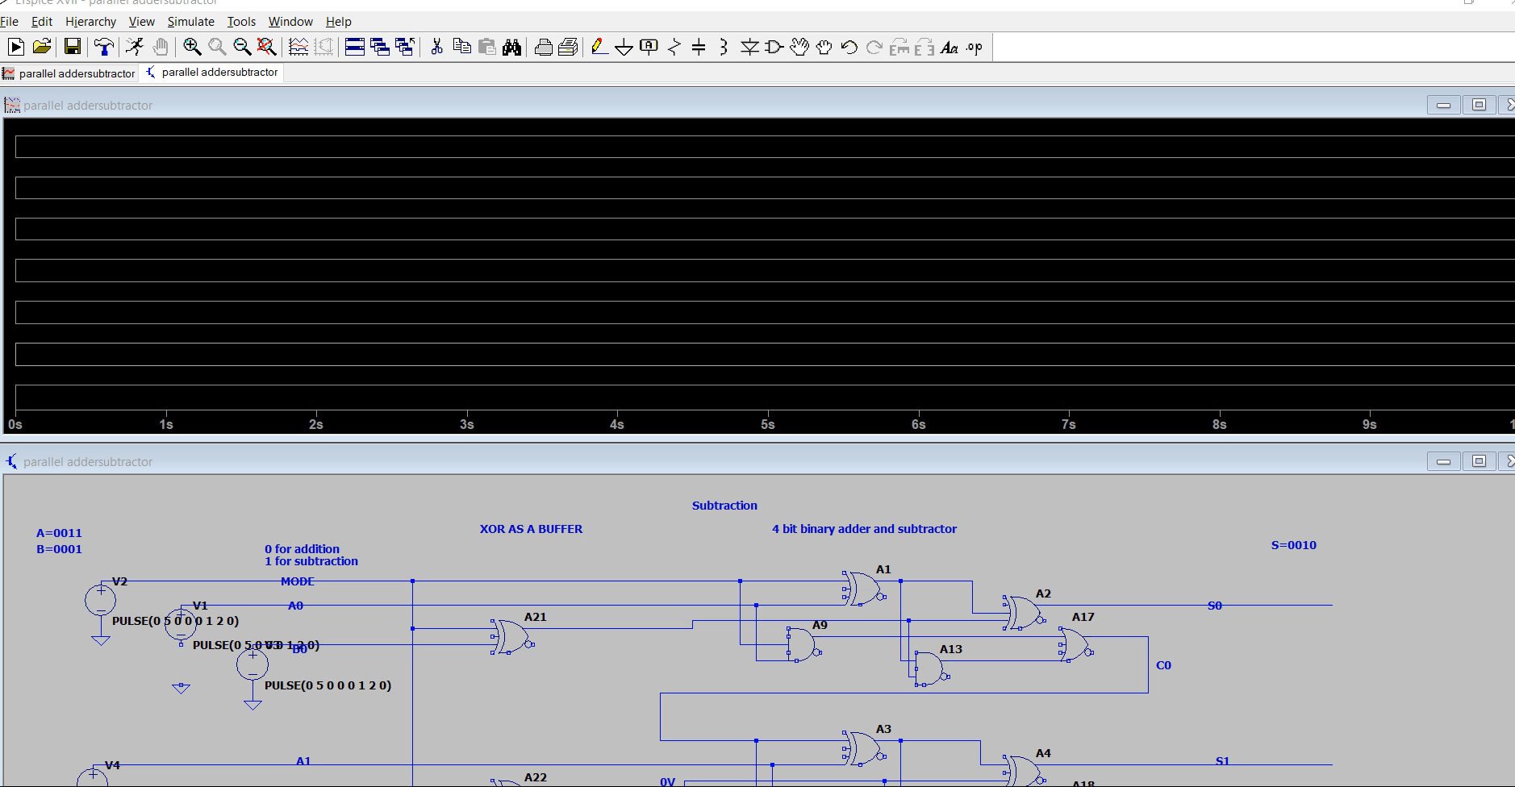

Slide 11
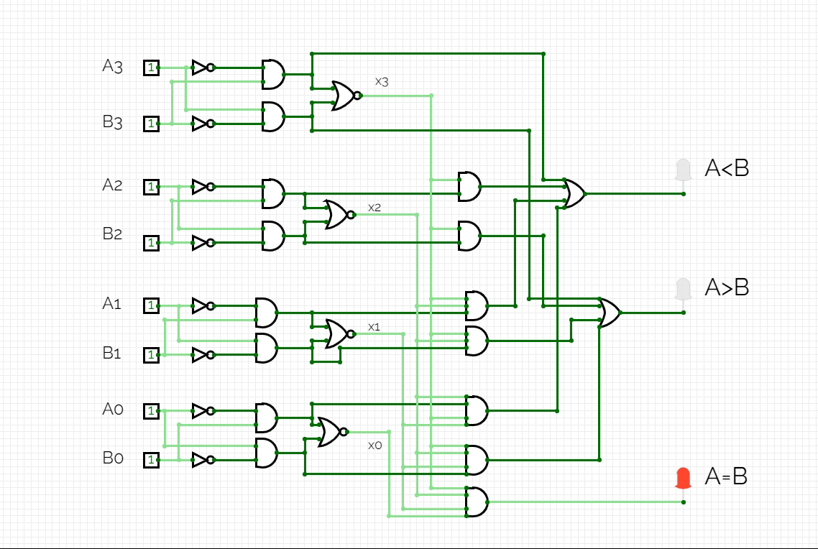
Simulation Of Magnitude Comparator :

Slide 12
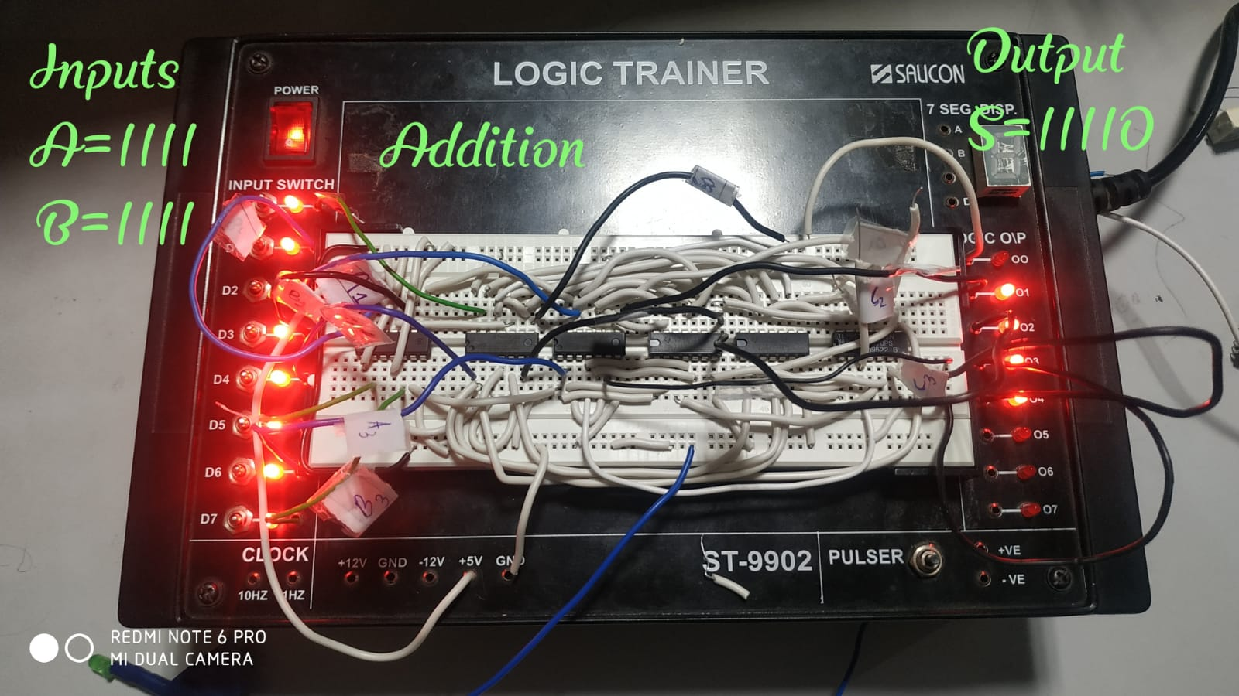
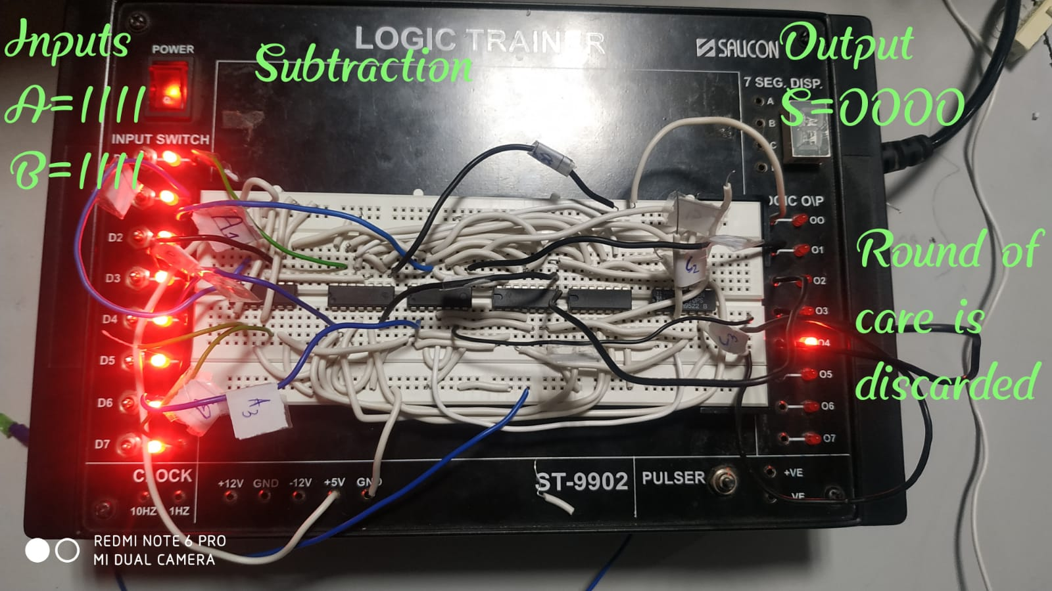
Pictures of Hardware Implementation:
Fig 1
Fig 2

Slide 13
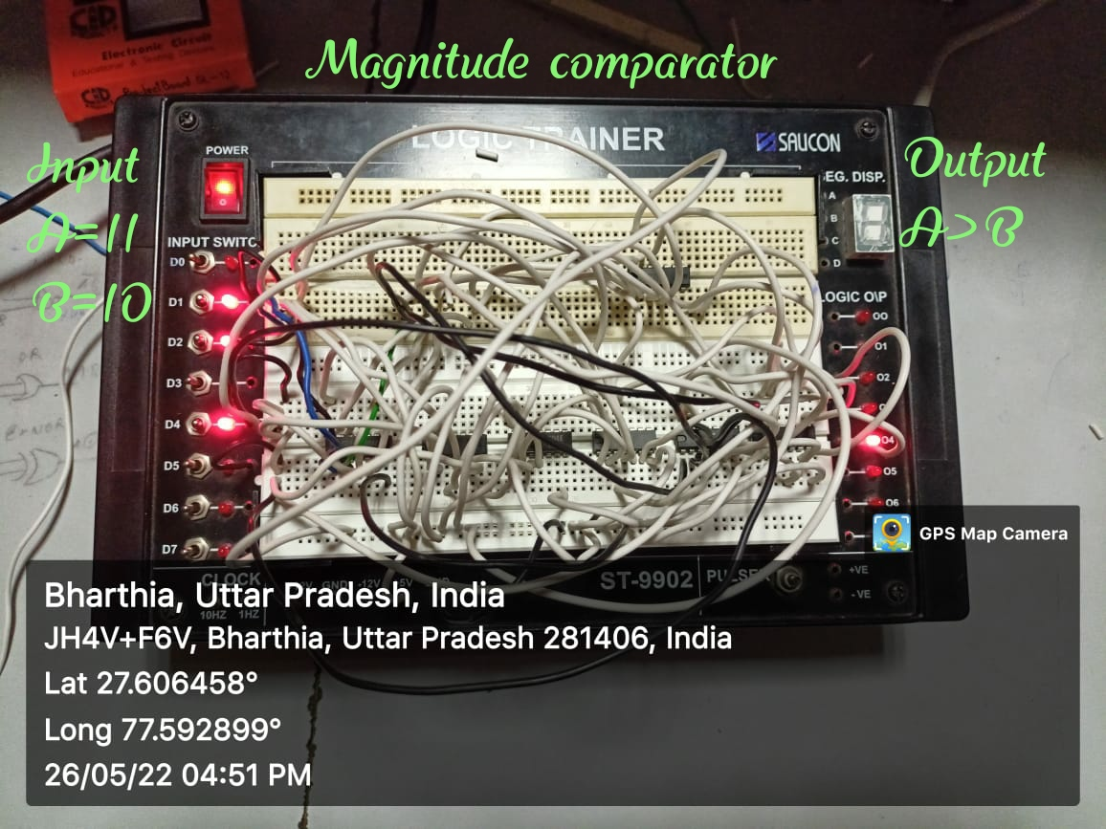

Fig 3
Fig 4

Slide 14
Applications Of Magnitude Comparator:
Microcontrollers
Central Processing Unit
Representing physical variables such as temperature

Slide 15
Reference:
Digital Design by M. Morris Mano and Michael D. Ciletti.
Digital Circuits And Design by S. Salivahanan and S. Arivazhagan
www.geeksforgeeks.org

Slide 16
THANK YOU

